Slide 1
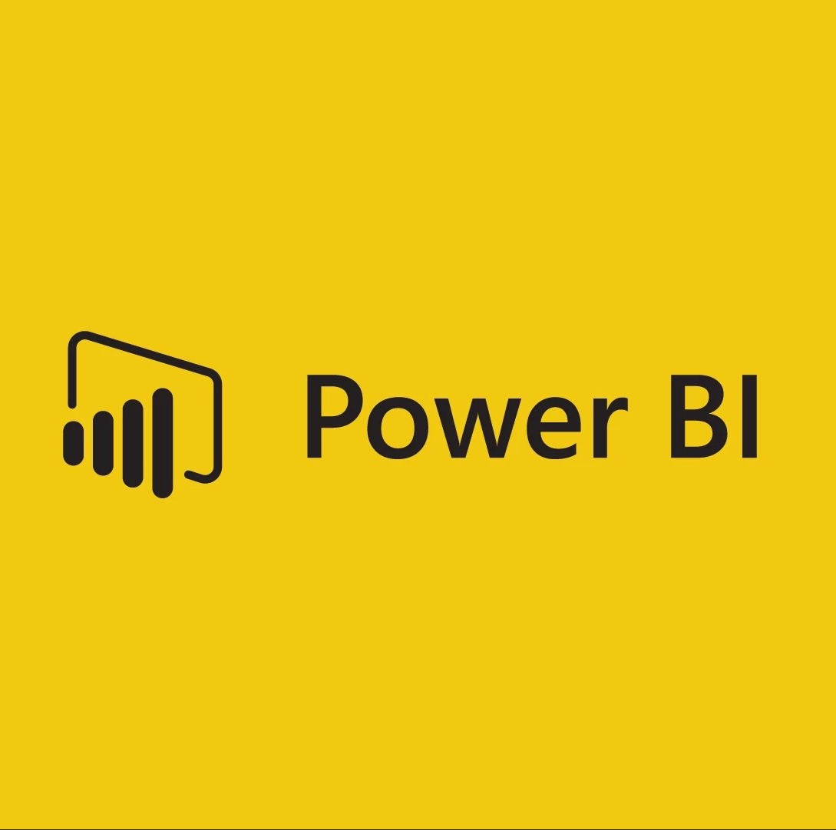
Visualising your Azure SQL Data Warehouse with Power BI
Soheil Bakhshi
23 Jan 2016
Notes:
Hello and welcome to Pass Business Intelligence Virtual Chapter.
This webinar, as you know, is about “Visualising your Azure SQL Data Warehouse with Power BI”.
First of all, I would like to thank you all for joining us and I hope you had a wonderful holiday.

Slide 2
About me
Aotearoa
LinkedIn Profile https://nz.linkedin.com/in/bakhshi
Website www.biinsight.com
New Zealand
Photos from:
http://blog.experiencenz.com
http://mostbeautifulplacesintheworld.org
http://joemcmenamin.com
Notes:
I’m Soheil Bakhshi, BI/DW Consultant, Microsoft MCP, MCSE, MCSA, MCITP and MCTS. You can find more information about me on my LinkedIn profile: https://nz.linkedin.com/in/bakhshi
You’re also welcome to visit my website www.biinsight.com

Slide 3
Agenda
Introduction to Power BI and Azure SQL Data Warehouse
Visualisation Requirements
Azure SQL Data Warehouse Installation/Configuration
Connecting Azure SQL Data Warehouse to Power BI Service
Creating Simple Reports on Power BI Service
Visualising Azure SQL Data Warehouse Using Power BI Desktop
Conclusion
Q&A
Notes:
In this session we will look at two amazing new cloud technologies from Microsoft. Azure SQL Data Warehouse and Power BI. Both technologies are growing very quickly and it is exiting that they can talk to each other very effectively.
In this session we’ll cover the following subjects:
First of all, I’ll go through some brief introduction of both technologies. I’ll review some common definitions that will be used regularly during this webinar.
Then I will talk about the visualisation requirements that should be met
Then I’ll discuss how to install and configure “Azure data Warehouse” through Azure Portal
After that I’ll show you how to connect Azure SQL Data Warehouse to Power BI Service
In this module you’ll see how to create very simple reports in Power BI Service and the real world challenges you might face
Then you’ll learn how to use “Power BI Desktop” to create repots on top of your “Azure SQL Data Warehouse”
Finally, we’ll go through some conclusions
Should you have any questions, please do not hesitate to ask me during the webinar

Slide 4
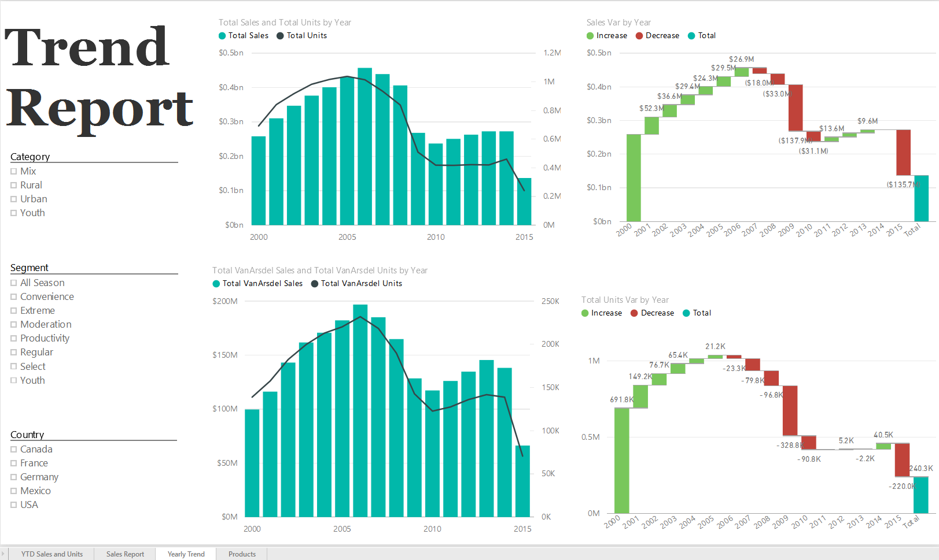
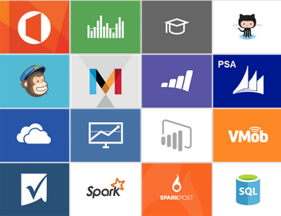
Introduction – Power BI
Datasets
Reports
Notes:
Datasets: A dataset is a collection of data that you import from or connect to several supported data sources like SQL Server, Excel files, Azure SQL Data Warehouse and many more. You can use Power BI to bring all of your data together, see it all in one place and access it from all of your devices.
Reports: A report is a view of your data which can have multiple visualisations that represent different perspectives and insights from that data.

Slide 5
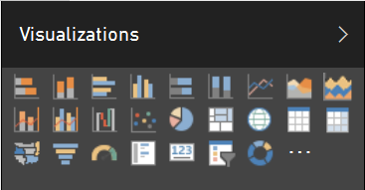
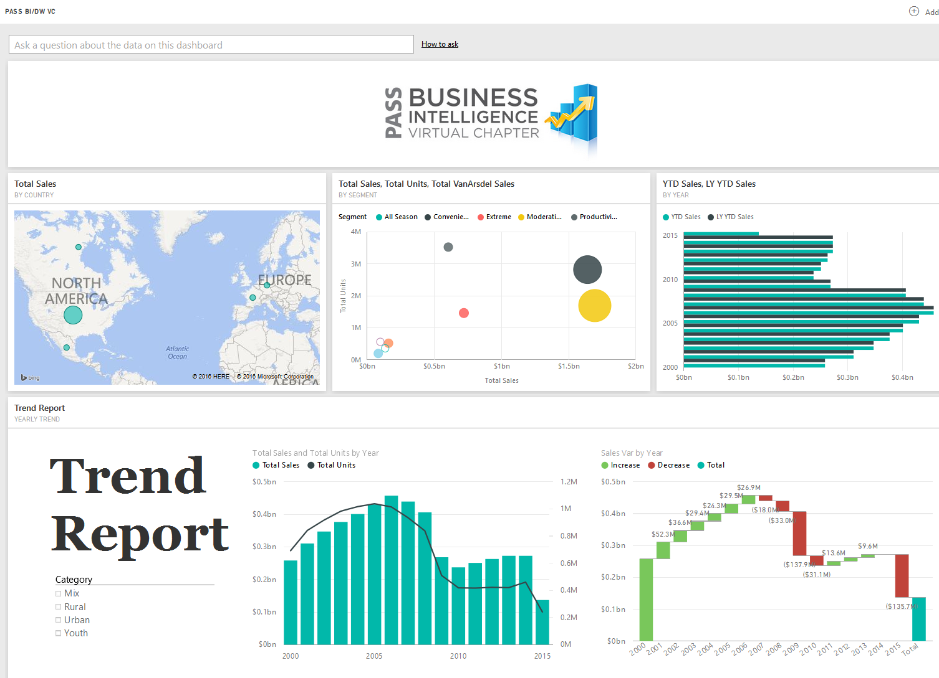
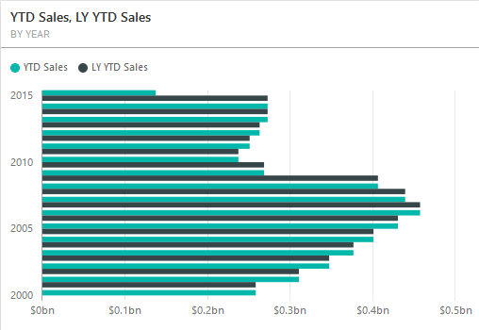
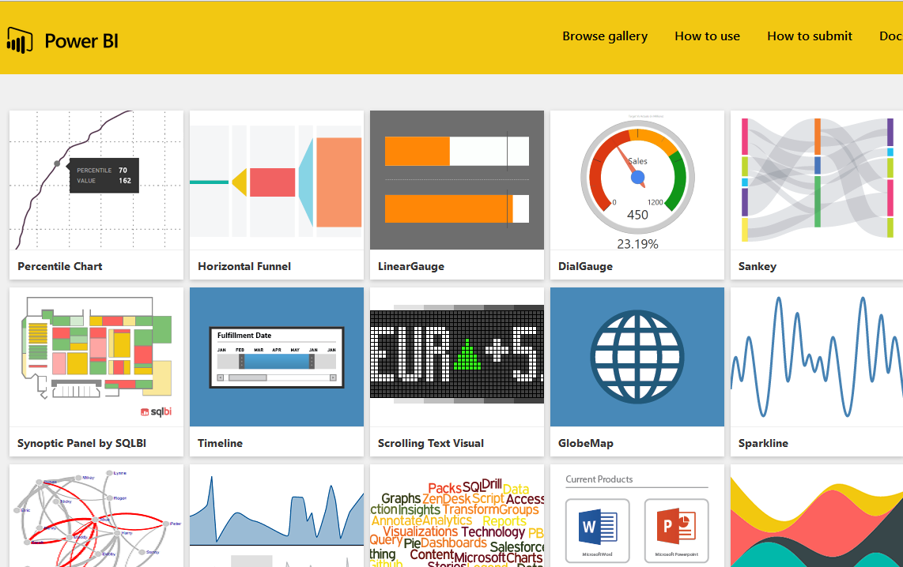
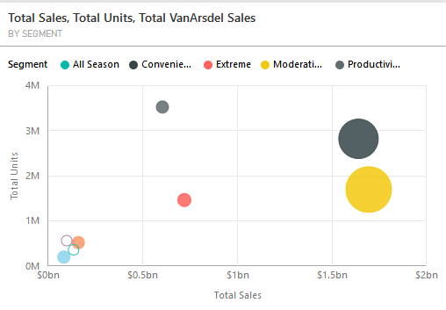
Introduction – Power BI
Visualisations
Dashboards
Tiles
Notes:
Visualisations: Each predefined or custom charts and graphs that are ready to use in a report.
Dashboards: A dashboard combines all data in a single pane that provides a consolidated view across the organization regardless of where the data lives. You can create dashboards only in Power BI service.
Tiles: A tile is indeed a snapshot of your data pinned to the dashboard. A tile can be created from a report, dataset, dashboard, from a Q&A question box, Excel, and from SQL Server Reporting Services (SSRS). As tiles are elements of a dashboard you can see them only in Power BI service.

Slide 6
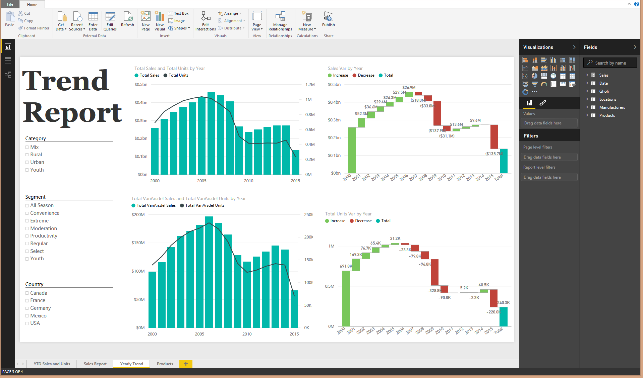
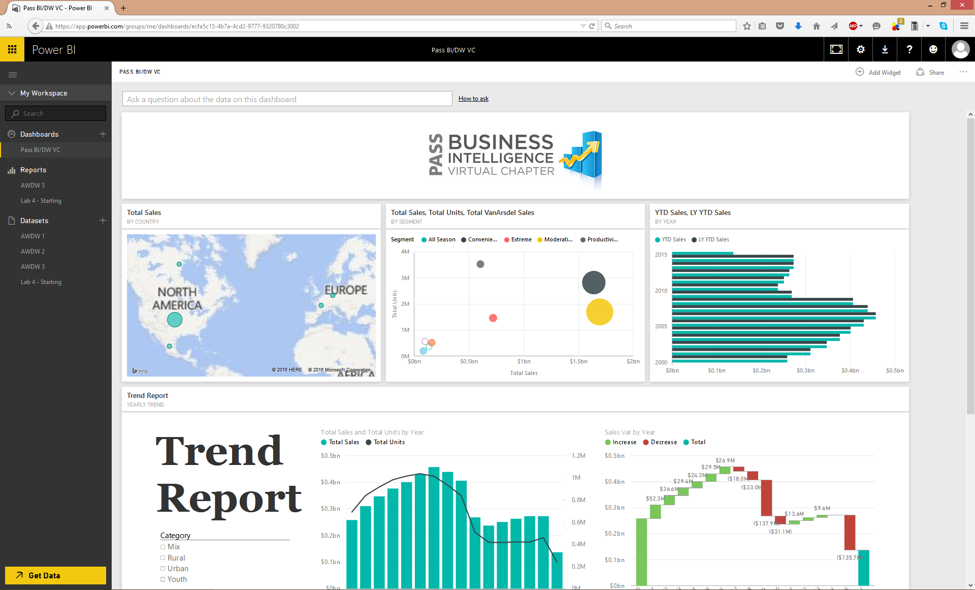
Introduction – Power BI
Power BI Desktop
Power BI Service
Notes:
Power BI Desktop: Power BI Desktop is indeed a desktop application for report authoring. You can load data from lots of different data sources and create a collection of queries and data connections using Power Query engine. You can then create flashy reports that can easily be shared with others. Power BI Desktop integrates different technologies like Power Query, data modelling, and visualisations to make our life easier to create awesome reports.
Power BI Service: The Power BI service is an online Software as a Service (SaaS) offering from Microsoft Power BI displays dashboards that are interactive, and can be created and updated from many different data sources. It is built on Azure, which is Microsoft’s cloud computing infrastructure and platform.

Slide 7
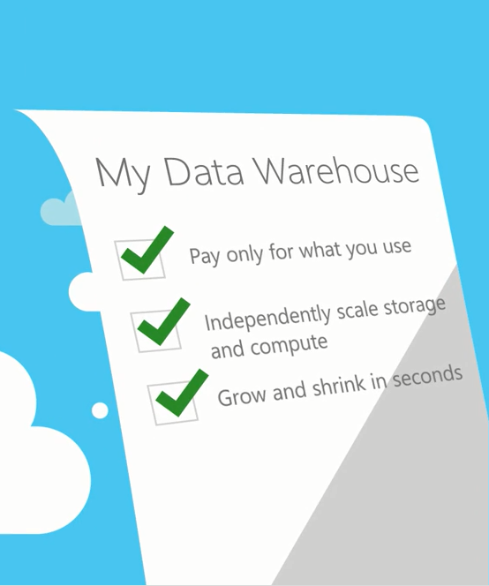
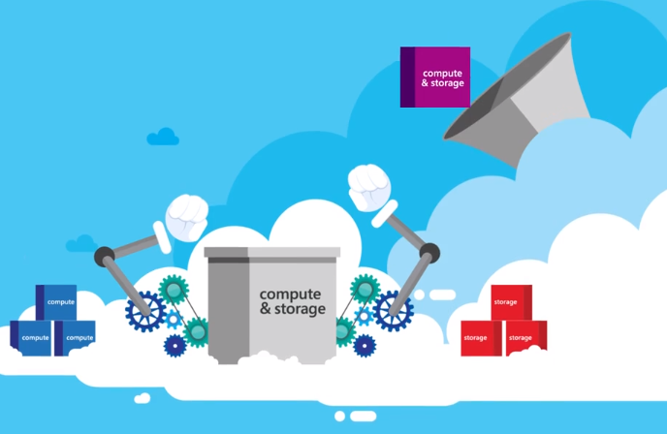
Introduction – Azure SQL Data Warehouse
Compute
Storage
T-SQL
Compute
Storage
Images from: https://azure.microsoft.com/en-us/documentation/videos/azure-sql-data-warehouse-overview/
Notes:
Into:
Azure SQL Data Warehouse service is the industry’s first enterprise-class cloud data warehouse that can grow or shrink in seconds.
Other cloud data warehouses lack key enterprise features like Stored Procedures, Partitioning and Indexes forcing you to build a new data warehouse from scratch.
T-SQL:
In contrast Azure SQL Data Warehouse is the first cloud data warehouse to offer a real SQL Server experience the customers expect.
With PolyBase, SQL Data Warehouse offers the ability to combine data sets easily.
You can use TSQL to query across both structured and semi-structured data like Hadoop.
Elasticity:
Slow elasticity also prevents cloud adoption. In other cloud data warehouses, the users choose machine instances with the amount of storage needed.
The could data warehouse combines “Compute” and “Storage” to create fix packages which makes scaling up or down a time consuming and expensive process.
In contrast in Azure SQL Data Warehouse, users scale compute resources and storage independently.
Pause:
With the ability to Pause the customers only pay for storage at a very cost effective cloud scale when idol.
In other cloud data warehouses LIKE Amazon RedShift the users can shut down a cluster if they don’t need to use it for a period of time, but first, they need to export the data warehouse contents to a storage service.
Then they need to restore data when creating another cluster.
In contrast in Azure SQL Data Warehouse you can Pause the service whenever you want by just a simple click.
Enterprise SQL:
Azure SQL Data Warehouse uses a cloud based Massive Parallel Processing (MPP) architecture which originally designed to run large on-prem enterprise data warehouses.
As a distributed database, Azure SQL Data Warehouse is capable of processing petabytes volumes of relational and non-relational data to maintain both performance and scale.
Migration/Design Considerations:
So not all SQL Server database features are implemented inside Azure SQL Data Warehouse.
Therefore, you need to consider un-supported features in your migration plan or your data warehouse design.
Some features like primary keys and foreign keys are NOT supported in Azure SQL Data Warehouse which can affect the way we use Power BI.
Without primary keys and foreign keys there is no physical relationship between the tables.
So Power BI service cannot detect any relationships by itself.
There is a workaround for this that we can create some SQL views in Azure side to make it work.
However, this can be an expensive solution.
The other way is to load the data warehouse into a Power BI Desktop model which can detect the relationships automatically.
Then publish the model to Power BI Service.
I will cover all scenarios during this webinar.
Pre Demo:
I leave it to you to learn more about Azure SQL Data Warehouse.
Now you know a bit bout Azure SQL Data Warehouse let’s talk more about Visualising Azure SQL Data Warehouse data with Power BI.

Slide 8
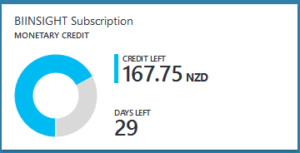
Azure SQL Data Warehouse Requirements
https://azure.microsoft.com/en-us/pricing/free-trial/
Notes:
First things first.
You need to have a Microsoft Azure subscription.
If you don't already have it, you can use it for a one-month trial here.
You'll also get $250 credit.
But, remember that if you succeed the $250 in less than a month then your services will stop working and you'll need to pay for it if you want to use it longer.

Slide 9
Visualisation Requirements
Having a Power BI Account (Power BI Pro)
Power BI Desktop (https://powerbi.microsoft.com/en-us/desktop)
Microsoft Azure subscription (https://azure.microsoft.com/en-us/pricing/free-trial/)
Install Azure SQL Data Warehouse service
Configure Firewall Settings (From Azure Portal or SSMS 2016 CTP3.2)
Notes:
To visualise your Azure Data Warehouse data with Power BI Service OR Power BI Desktop you need to meet the following requirements:
You also need to have Power BI Pro account
You need to have Power BI Desktop installed on your machine. You can download the latest version of the tool from here: https://powerbi.microsoft.com/en-us/desktop
You need to have Microsoft Azure subscription. If you don’t, you can try it for free for month or $250. You can get the free trial from here: https://azure.microsoft.com/en-us/pricing/free-trial/
Then you need to install Azure SQL Data Warehouse service
You’ll also need to configure Firewall Settings to be able to use Power BI Desktop (From Azure Portal or SSMS 2016 CTP3.2)

Slide 10
Azure SQL Data Warehouse Installation/Configuration Visualising SQL Data Warehouse Data with Power BI and Power BI Desktop
DEMO
Notes:
Demo Scenarios
Installing and configuring Azure SQL Data Warehouse
Installation
Installing Azure SQL DW
Configuration
Configure Server Firewall using:
Azure Portal
SSMS 2016
Connecting Azure SQL Data Warehouse to Power BI Service
There are two options to connect Azure SQL Data Warehouse to a Power BI Service:
Using “Open in PowerBI” button
Connecting from the Power BI Service (Get Data)
Using “Open in Power BI” button from Azure Portal
Advantages:
Easy to connect {+}
Storage is limited to the available storage in your Power BI Service Which is 10 GB per Pro account {+}
Schedule refresh is NOT needed {+}
Disadvantages:
Power BI Service cannot detect any relationships {big -}
Enabling “Cortana” is NOT supported {-}
Q&A is NOT available {-}
Quick Insights NOT supported {-}
Workaround:
After installing Azure SQL DW remember to create a SQL view...
NOTE:
When we connect Azure SQL DW to Power BI Service the DW structure will load into the Power BI Service.
So if we create any new SQL objects after connecting to Power BI Service, Power BI will be unable to see those objects.
We will need this for the next modules.
Connecting from the Power BI Service (Get Data)
Connecting from Power BI Service to Azure SQL DW
NOTE:
Create a simple report using Fact Internet Sales
Visualising Azure SQL Data Warehouse with Power BI Desktop
There are also two options for visualising your Azure SQL DW with Power BI Desktop:
Import data into the model
DirectQuery
Import Data into the Model
Advantages:
You can manage relationships {+}
Quick Insights supported {+} (https://powerbi.microsoft.com/en-us/documentation/powerbi-service-auto-insights-types/)
You can enable “Cortana” to access the dataset {+}
Q&A is available {+}
Ability to creating new Measures and Calculated Columns {+}
Ability to use DAX functions {+}
Ability to use Power Query engine and implementing user defined functions using M {+}
Disadvantages:
There is a 250 MB storage limitation per dataset in Power BI Service after publishing the model {-}
You have to setup Schedule Refresh if needed. So it is not good for real-time monitoring purposes {-}
Direct Query
Advantages:
The storage would be limited to the available storage in your Power BI Service which is 10 GB for a Power BI Pro account {+}
No need to setup Schedule Refresh so it is ideal for near real-time monitoring {+}
Note: Tiles are refreshed approximately every 15 minutes (refresh does not need to be scheduled).
Disadvantages:
In Direct Query Mode Power BI Desktop won’t detect any relationships, so we must create relationships manually {-}
Cortana is NOT available {-}
Q&A is NOT available {-}
Quick Insights is NOT supported {-}
New Measures or Calculated Columns are NOT available {-}
DAX is NOT available {-}
Power Query engine and M are available (Semi-functional) {-}

Slide 11
Conclusion
 | Connecting Azure SQL DW to/from Power BI Service | Power BI Desktop Import Data | Power BI Desktop DirectQuery
Easy To connect | Very Easy | Easy | Easy
Storage Limitation | Power BI Pro Storage 10 GB | 250 MB Per Dataset (Published Model) | Power BI Pro Storage 10 GB
Automatic Data Refresh (Near Real-time) | Available | Unavailable | Available
Schedule Refresh | Unavailable | Available | Unavailable
Manage Relationships | Unavailable | Available (Semi-automatic) | Available
Enabling “Cortana” | Unavailable | Available (Published Model) | Unavailable
Q&A | Unavailable | Available (Published Model) | Unavailable
Quick Insights | Unavailable | Available (Published Model) | Unavailable
DAX | Not Applicable | Available | Unavailable
Power Query (M) | Not Applicable | Available | Semi-functional

Slide 12
References
http://blogs.technet.com/b/dataplatforminsider/archive/2015/05/05/azure-sql-data-warehouse-updates-for-build.aspx
https://azure.microsoft.com/en-us/documentation/videos/azure-sql-data-warehouse-overview/
https://azure.microsoft.com/en-us/services/sql-data-warehouse/
Azure Documentation:
https://azure.microsoft.com/en-us/documentation/articles/sql-data-warehouse-get-started-provision/
Power BI Documentation
https://powerbi.microsoft.com/en-us/documentation/powerbi-service-get-started/

Slide 13
THANK YOU

